Slide 1
Tutorial 6
Creating Fixed-Width Layouts

Slide 2
Objectives 6.1
Understand Web page layouts
Create a two-column layout
Use universal and id selectors to create styles
Create page structure with container sections and the header, nav, section, aside, and footer elements
Specify fixed column widths using pixels

Slide 3
Objectives 6.2
Create a three-column layout
Create a box shadow around an element
Add rounded corners to borders
Create a figure element with a caption
Import CSS styles using the @import rule

Slide 4
Web Page Layouts
The term broken layout is used to describe layouts that do not appear on the screen as planned.
In a fixed-width layout, the page and columns are set to certain widths using pixel values.
A fluid layout expands and contracts so the content fills the entire screen width.

Slide 5
Two-Column Fixed Layout
A horizontal header block at the top of the page usually includes a corporate logo or banner advertising. This will be identified using the header element.
A horizontal navigation bar for links, or navbar, is a row that is usually placed just below the header. This will be identified using the nav element.

Slide 6
Two-Column Fixed Layout
A sidebar is a narrow column used to display a list of links or content of secondary importance. This will be identified using the aside element.
A main content area is a wide column used to display the primary page content. This will be identified using a section element.
A horizontal footer row at the bottom of the page usually displays contact information for the Web site and sometimes displays links to other Web pages at the site. This will be identified using the footer element.

Slide 7
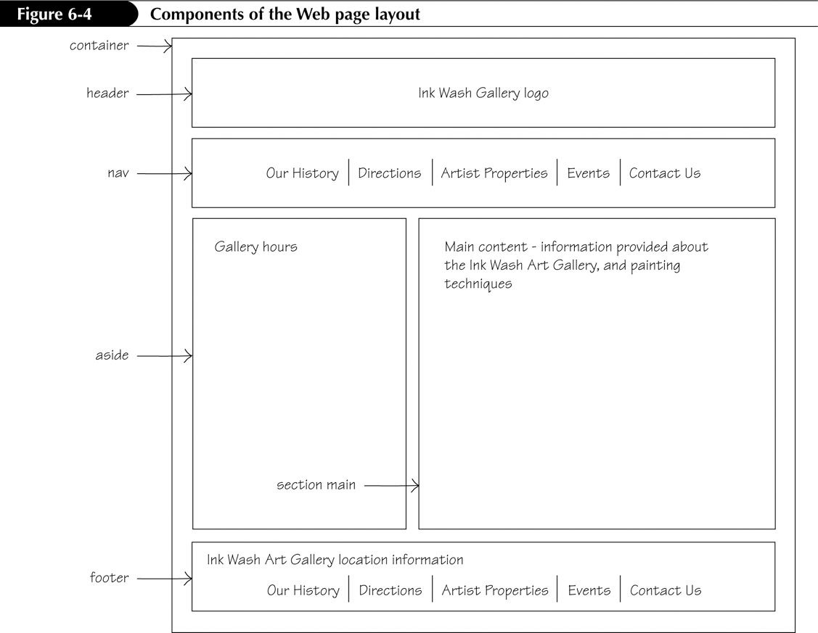
Components of the Layout

Slide 8
Using the Universal Selector
It is a good coding practice to zero out, or cancel, any margins and padding that browsers might add to a Web page by default.
The universal selector is used to select all of the elements on a Web page. In CSS code, the universal selector is represented by an asterisk.
Entering the following lines of code at the start of your style
sheet removes the default browser margins and padding from
every element (the asterisk applies the styles to all selectors):
* {
margin: 0;
padding: 0;
}

Slide 9
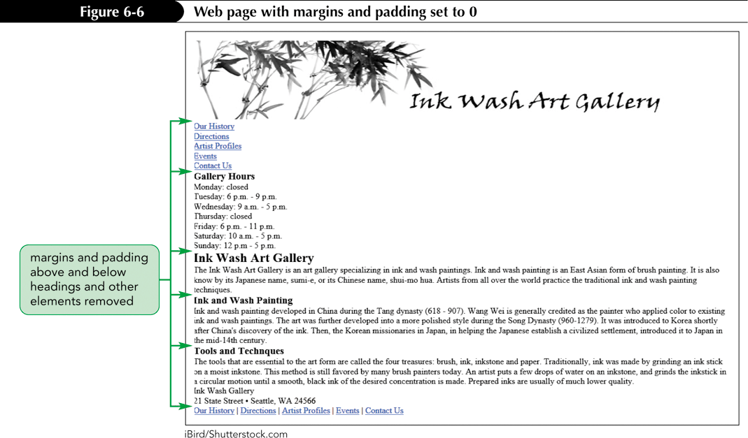
Universal Selector Example

Slide 10
Creating the Container Section
A container section serves as a large box in which you can place all the other boxes.
Using a container section can serve several important functions:
  It can determine the width of the page layout.
  It can be used to center the layout horizontally.
  It can have a border applied around it.
  It can be used to apply a background color or image to contrast the background color or image of the body element.

Slide 11
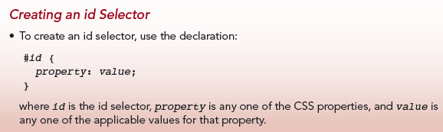
Creating the Container Section
The section element with an id selector is used to style a section in a Web page when there isn’t another appropriate element to describe the content such as nav, header, or footer.
The id selector name is preceded by the # flag character.

Slide 12
Determining the Content Width
To determine the value for the width property of an element to be used for column content:
  If an element such as a header or footer element spans the entire container, subtract the sum of the left and right margins, borders, and padding values from the width of the parent container to determine the content width.
  For side-by-side columns, choose an appropriate content width for each column.
  Columns of secondary importance, such as a sidebar, should be narrow.
  The column of primary importance should be the widest.

Slide 13
Types of Widths
The parent container width is the width of the containing box.
The content width is the width of the content inside a container.
The column width is the sum of the content, left and right padding, left and right border widths, and left and right margins.
The sum of the column widths cannot exceed the width of the parent container.

Slide 14
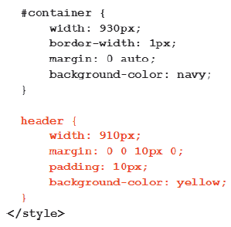
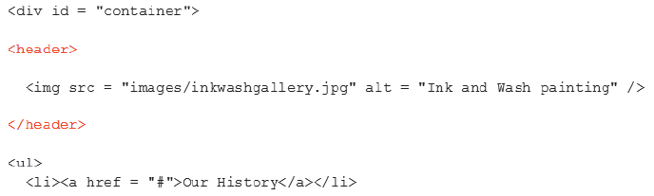
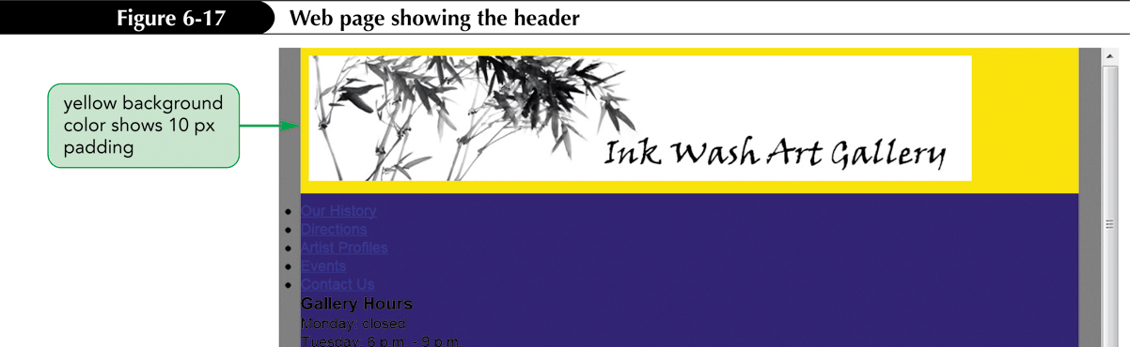
Styling the Header Selector

Slide 15
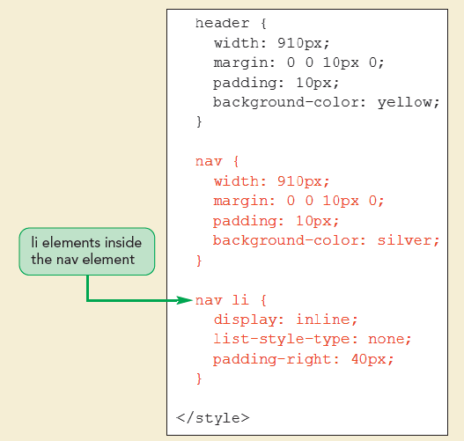
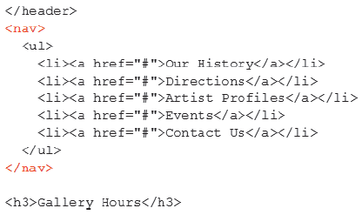
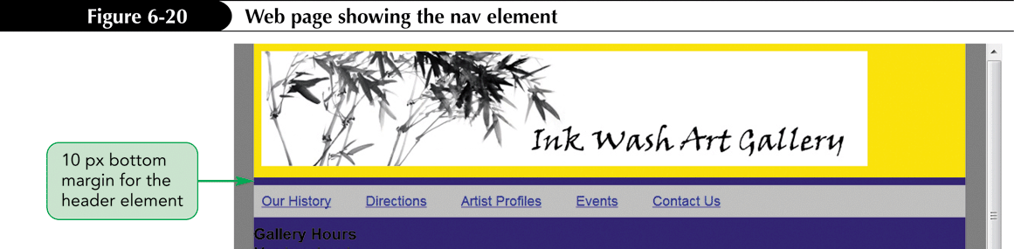
Styling the Navbar

Slide 16
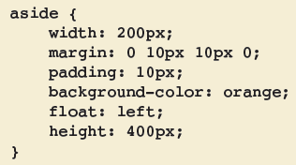
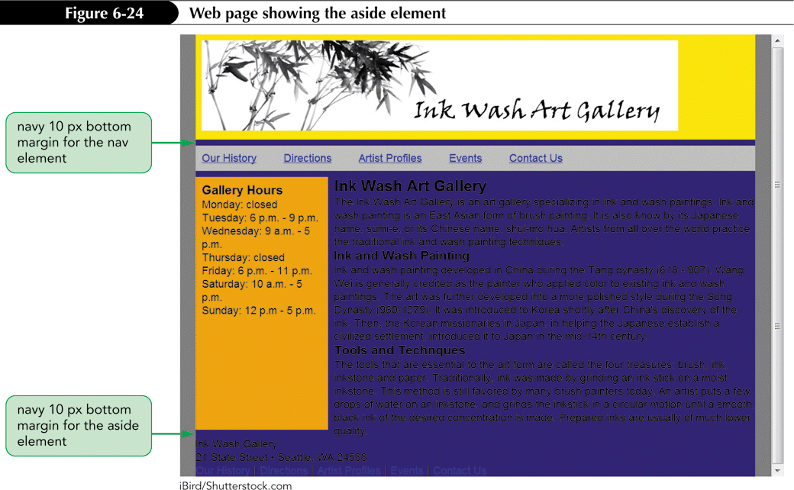
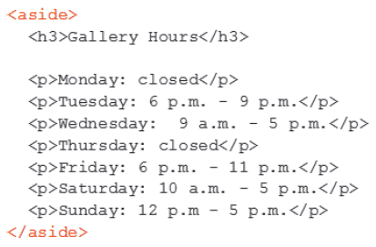
Using the aside Element
The aside element is an HTML element that marks content that is not the main content.

Slide 17
Dependent id Selectors
A dependent id selector can be applied to only a particular element.
An independent id selector can be applied to any element.
Independent: #highlight {
  background-color: yellow;
  }
Dependent: div#container {
background-color: teal;
}

Slide 18
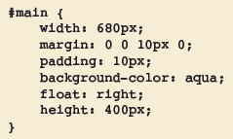
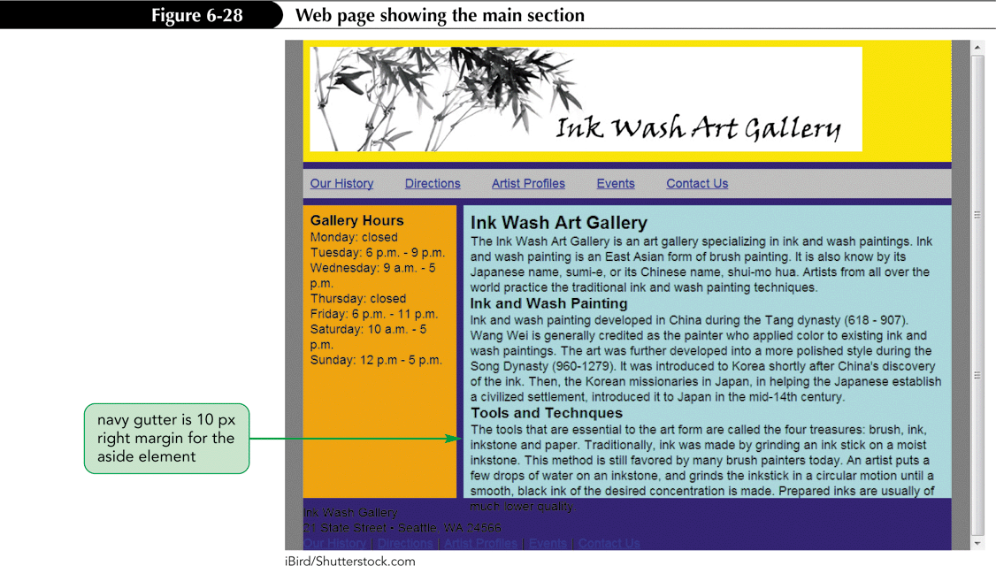
Styling the Main Column
HTML code goes here

Slide 19
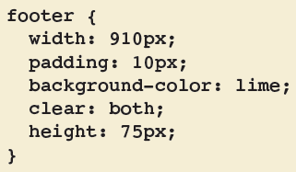
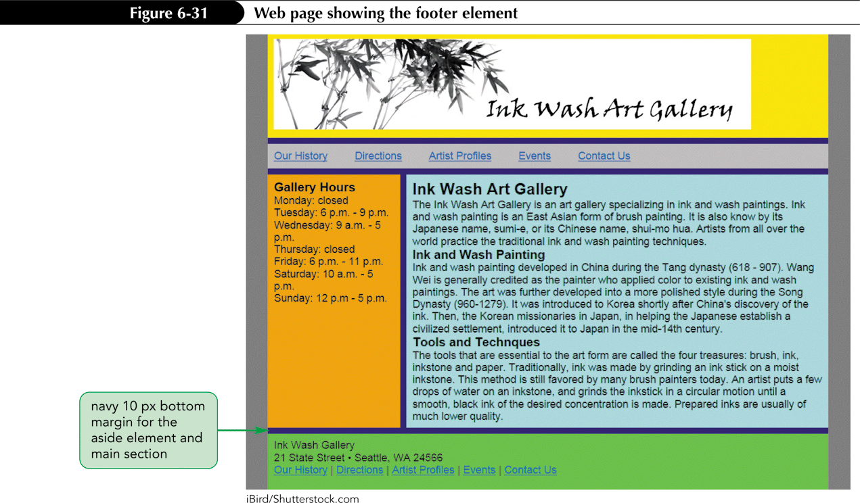
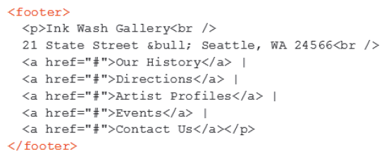
Styling the Footer

Slide 20
Positioning Properties
The document flow describes how the contents of the page are recognized by the browser.
When you use absolute positioning on an element, the element is displayed in the exact position you specify, no matter what elements surround it.
When you use relative positioning, by contrast, you shift an element’s position from the point where it normally would appear in the document flow.

Slide 21
Positioning Properties
The left property with a positive value positions an element a certain distance from the left edge of the screen, moving the element to the right.
The top property with a positive value positions an element a certain distance from the top edge of the screen, moving the element down.
The bottom property with a positive value moves an element up.
The right property with a positive value moves an element to the left.

Slide 22
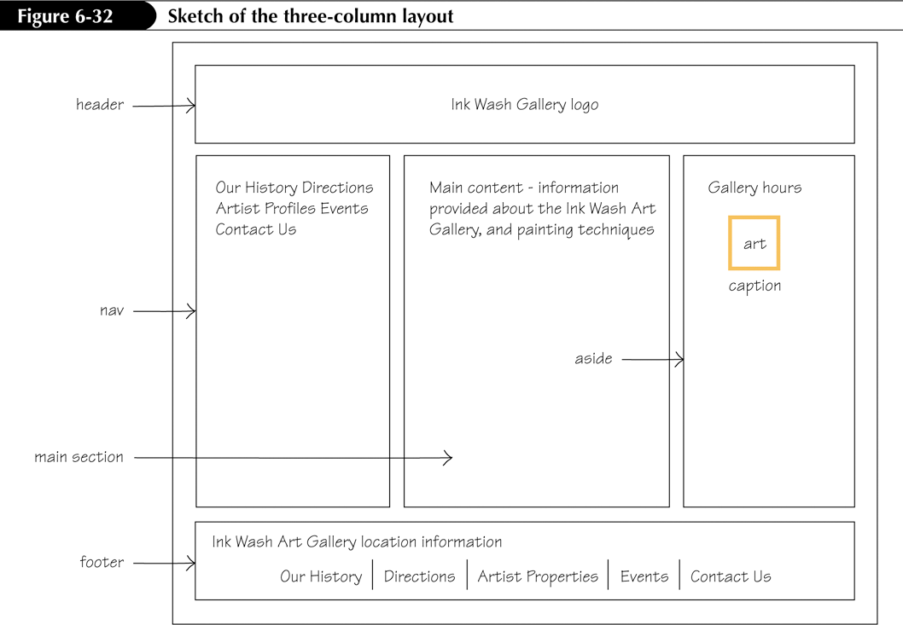
Three-Column Layout

Slide 23
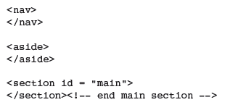
Interrupting the Document Flow
The source order is the order of page content in the document flow.
Normally, a browser reads content from top to bottom and left to right.
For columns that are side by side, floated elements must be displayed before nonfloated elements.
Example:

Slide 24
The box-shadow Property
The box-shadow property creates a 3D shadow effect.
The syntax for the box-shadow property is:
box-shadow: h-shadow v-shadow blur spread inset;
  h-shadow—The position of the horizontal shadow; shifts the shadow to the right, offset from the right edge of the element
  v-shadow—The position of the vertical shadow; shifts the shadow down, offset from the top edge of the element
  blur—The blur distance (optional)
  spread—The spread distance (optional)
  inset—Shadow placement inside the element, rather than outside (optional)

Slide 25
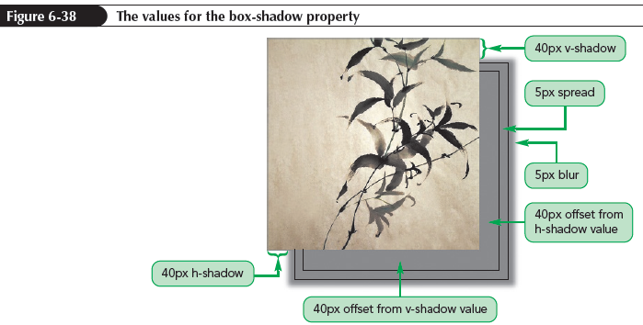
The box-shadow Property Example

Slide 26
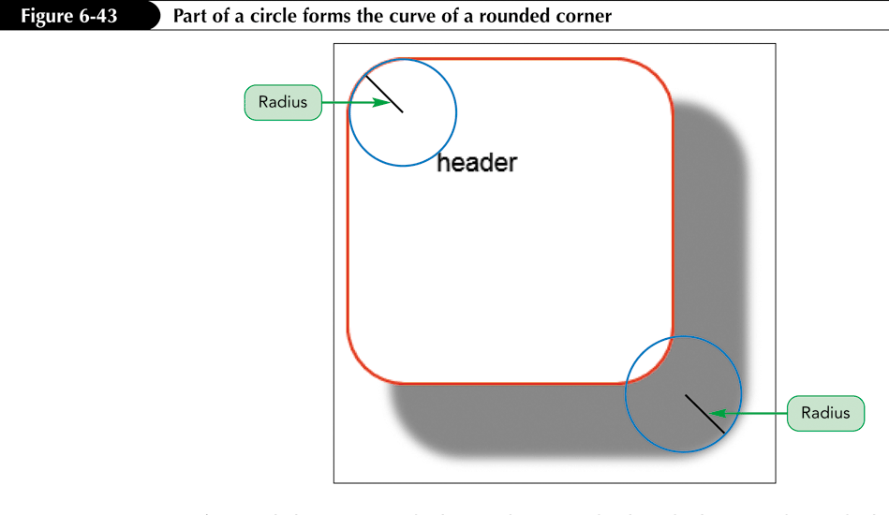
Creating Rounded Corners
Rounded corners can be created using the border-radius property.
The value for the border-radius property specifies a radius measurement.

Slide 27
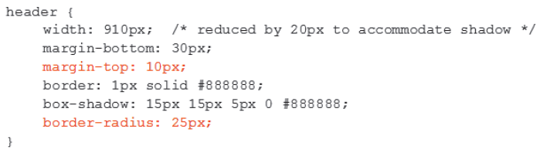
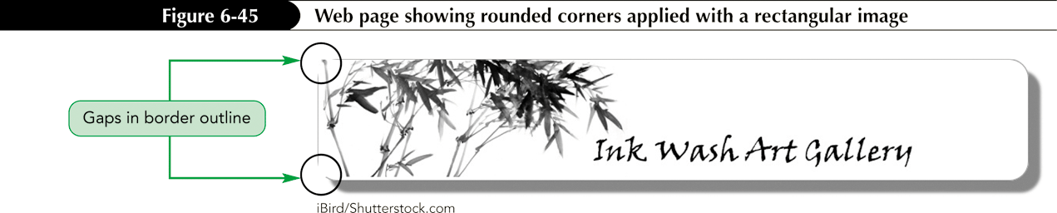
Rounded Corners Example

Slide 28
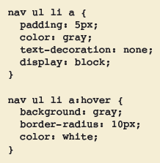
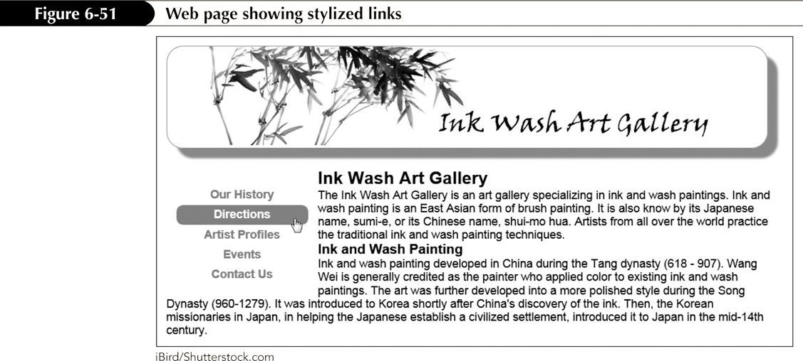
Stylized Links Example

Slide 29
Using the figure Element
An image can be used as a logo, a background image, a bullet for a list item, or the basis of an image map.
When an image is provided for informational purposes, it can be marked with the figure element rather than a paragraph or another block-level element.
The figure element can also include a caption, which you mark using the figcaption element.

Slide 30
Using the figure Element
Syntax for marking a figure:
<figure>
<img src = "imagefilename" />
</figure>
To include a caption with a figure, add:
<figcaption>caption</figcaption>
The figcaption content appears below the image.
The figcaption element is nested inside the figure element.

Slide 31
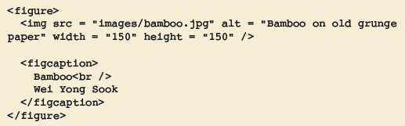
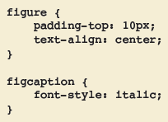
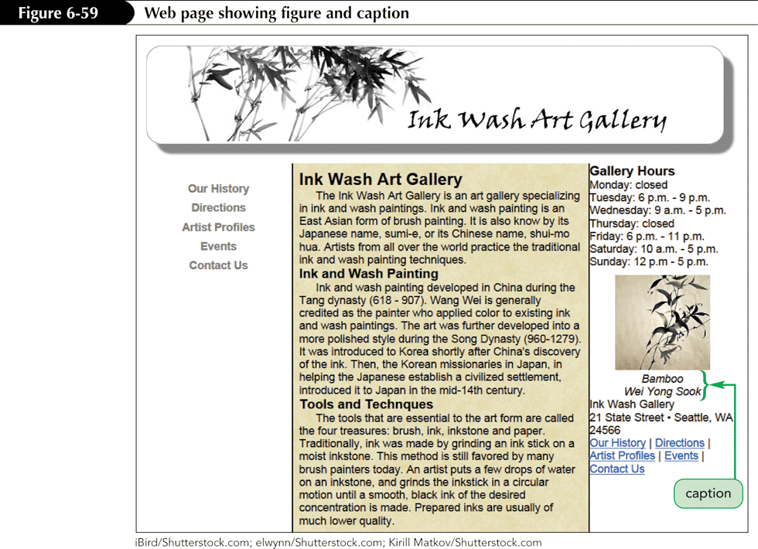
The figure Element Example

Slide 32
Using @import
A style sheet library is a collection of frequently used styles.
An external style sheet can be created.
You can link to an external style sheet, or you
can import those styles into either an embedded or external style sheet using the
@import rule.
The @import rule has the following syntax:
@import url(stylesheet_filename);

Slide 33
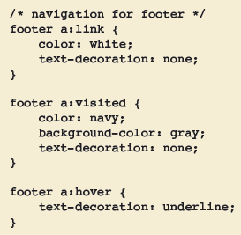
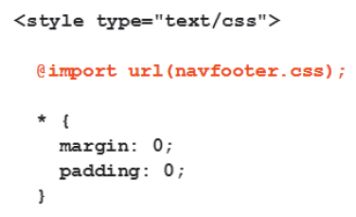
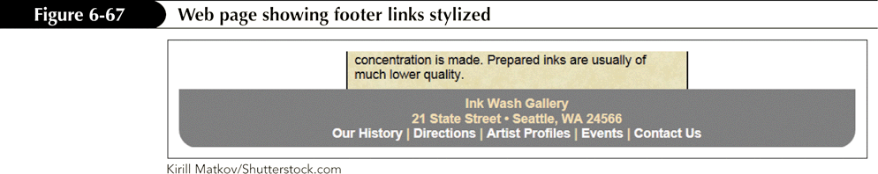
Using @import Example
navfooter.css

Slide 34
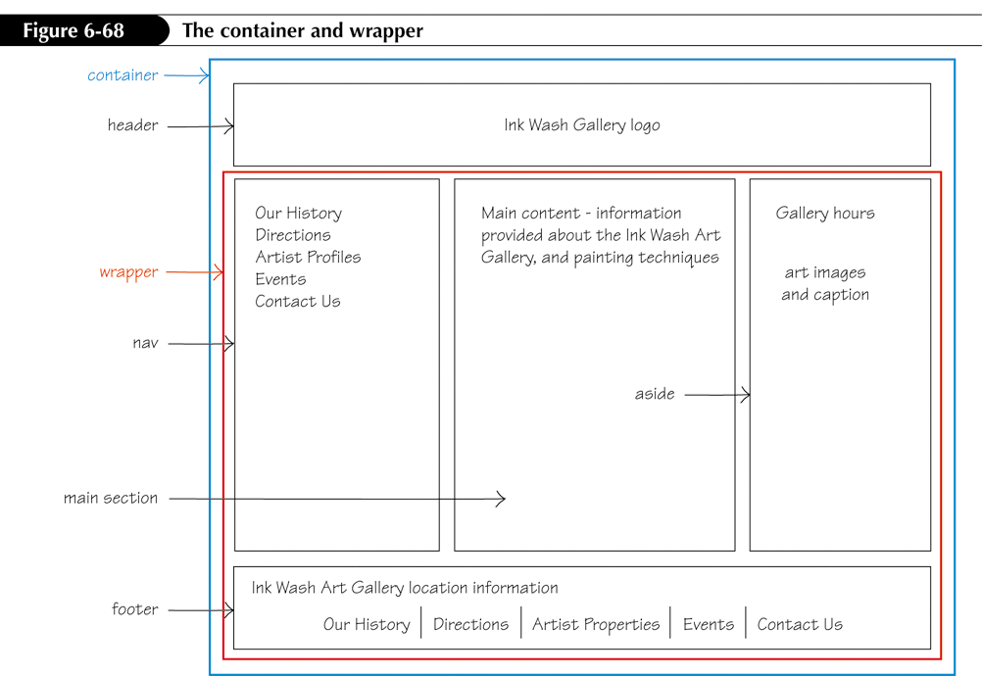
Creating the Wrapper Section

Slide 35
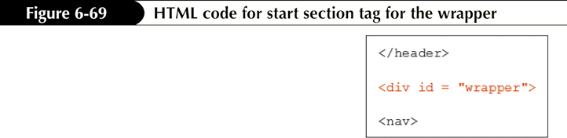
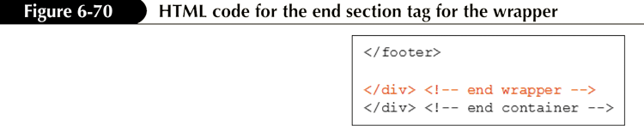
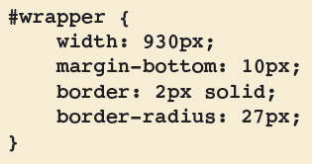
Creating the Wrapper Section

Slide 36
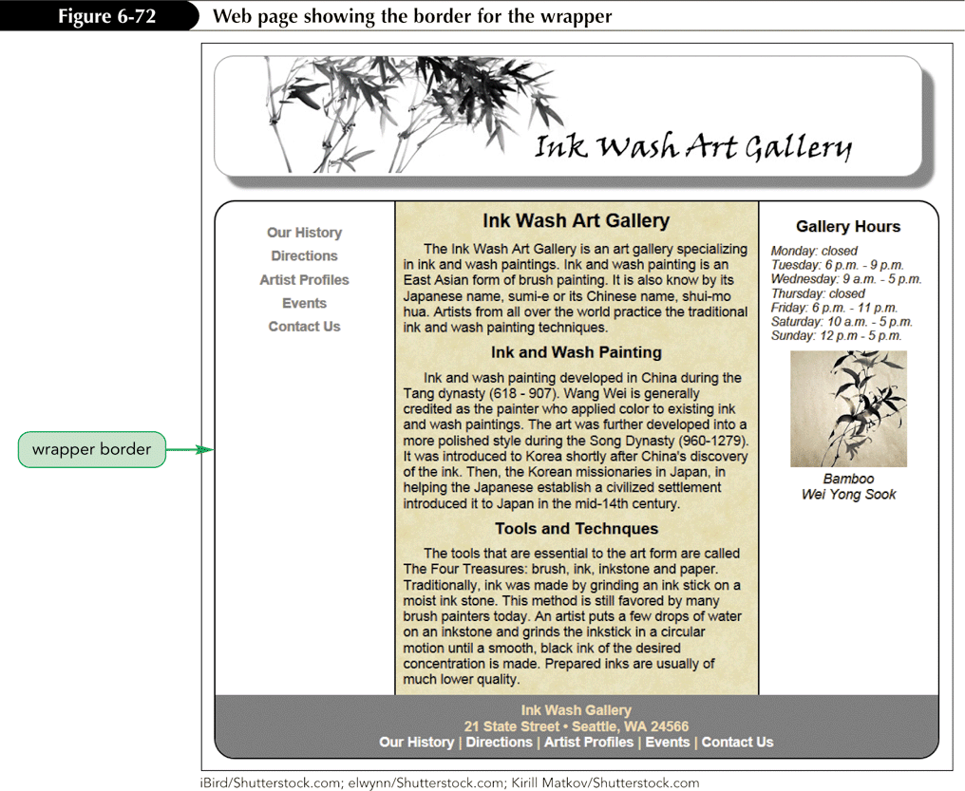
Creating the Wrapper Section

